Slide 1
SAP HANA ADMINISTRATON 2.0

Slide 2
SAP HANA Sizing
Sizing is a standard term in SAP, which means determining the hardware requirements of an SAP System such as physical memory, CPU power, and I/O capacity. Determining sizing requirement ensures that customers purchase hardware as per their business need and also ensures lower cost and reduce TCO.
The critical factor for SAP HANA implementation is the right sizing of the server based on the business requirement and this means correct calculation of amount of memory, the CPU processing power.
SAP HANA sizing consists of Memory sizing for static data, Memory sizing of objects created during runtime (data load and query execution), Disk Sizing and CPU Sizing. For the purpose of successful SAP HANA implementation, SAP has provided various guidelines and methods to calculate the correct hardware size. We can use any of the below method: 1. SAP HANA sizing using the QuickSizer tool 2. SAP HANA sizing using the DB specific scripts 3. SAP HANA sizing using the ABAP report
All available SAP certified HANA hardware configurations can be looked up in the HANA PAM (Product Availability Matrix). In addition SAP also certifies additional configurations as required by customer scenarios. You should check with your hardware vendors and SAP Account Executive in case you are interested in any other configuration than listed in the HANA PAM.
According to the sizing results, select a SAP HANA T-shirt size that satisfies the sizing requirements in terms of main memory, and possibly CPU capabilities.
For example, a sizing result of 400 GB for the main memory (C) suggests a T-shirt size of M.

Slide 3
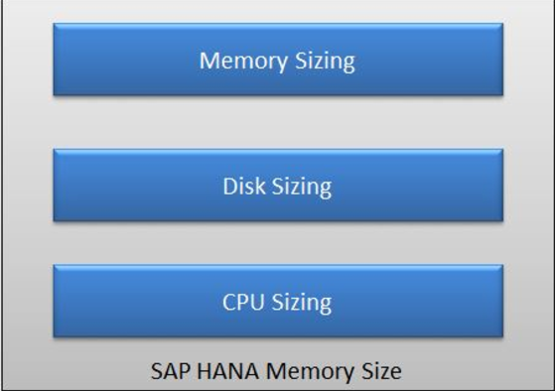
SAP HANA Sizing
Sizing of the SAP HANA appliance is mainly based on the required main memory size. Memory sizing is determined by the amount of data that is to be stored in memory. In general the sizing of other components within the server is derived from the main memory size. Apart from main memory sizing, other 2 important part of sizing is Disk Sizing and CPU Sizing. The three main KPIs used to size for SAP HANA is Main memory (RAM) space, CPU processing performance & Disk size
The RAM size is the basic figure to find the necessary T-shirt size.
Data is compressed in SAP HANA. Since the expected compression factor is not
the same for different scenarios, the main memory size is evaluated depending on the
scenario.
SAP HANA Main Memory Sizing is divided into static and the dynamic RAM
requirement. Static RAM Requirement:
The static RAM requirements relates to the amount of main memory that is used
for the holding the table data. Static memory sizing of HANA is determined by the amount of data that is to be
stored in memory. Dynamic RAM Requirement:
Additional main memory is required for objects that are created dynamically when new data is loaded or queries are executed. Since SAP recommends reserving as much memory for dynamic objects as for static ones, for calculating the total RAM the static RAM is multiplied by two.

Slide 4



Steps to Calculate RAM Size
1.Calculate Uncompressed Data Volume to be loaded in HANA - Source Data Footprint: Determine the information that has to be transferred (either by replication or extraction) to the SAP HANA database. Note that typically customers will only select a sub-set of information from their ERP or CRM database, so this has to be done at the table level. The sizing methodology is based on uncompressed source data size, so in case compression is used in the source database, this has to be taken into account as well. The current size of all the tables (without indexes) storing the required information in the source database is called Source Data Footprint.
2.Compression Factor in HANA In HANA as a side-by-side scenario, the expected compression was 1:5. Through new compression mechanisms the compression ratio increased to 1:7. There are, however, also significantly higher values, so customers are circulating examples where a factor has been achieved of over 1:50 The compression ratio achieved by SAP HANA can vary depending on the data distribution. 3.Calculation of Static RAM Size Static RAM Size means the amount of RAM required to store the data in the SAP HANA database. Assuming the compression factor as 7:
4.Calculation of Dynamic RAM Size Dynamic RAM is for additional main memory required for objects that are created dynamically when
new data is loaded or queries are executed. SAP recommends to keep Dynamic RAM size same as
Static RAM size.
5.Calculation of Total RAM Size
The total amount of RAM should be rounded up to the next T-shirt configuration size. For example, if total RAM size is 400 GB, then T-shirt size of M should be selected.

Slide 5


Disk Sizing:
SAP HANA is an in-memory database. But it still requires disk storage space — to preserve database information if the system shuts down, either intentionally or due to a power loss, for instance. Disk sizing can be categorized into Persistence Layer (also called Data Volume)
Disk Log (also called Log Volume)
Persistence Layer (Data Volume): Data changes in the database are periodically copied to disk to ensure a full image of the business data on disk in Data Volume (Persistence Layer).
The capacity for this storage is calculated based on the total amount of RAM: Disk Log (Log Volume): Log Volume saves log files to ensure that changes are durable and the database can be restored to the last committed state after a restart.
The minimum size for the Log Volume is equal to the size of the SAP HANA server‘s main memory.

Slide 6

CPU Sizing:
A CPU sizing only has to be performed in addition to the memory sizing if a massive amount of users working on a relatively small amount of data is expected. Choose the T-shirt configuration size that satisfies both the memory and CPU requirements. The CPU sizing is user-based. The SAP HANA system has to support 300 SAPS for each concurrently active user. The servers used for the IBM Systems Solution for SAP HANA support about 60 - 65 concurrently active users per CPU, depending on the server model.
What is SAPS? The SAP Application Performance Standard, known as SAPS is a unit of measurement that describes the performance (throughput result) of a SAP system configuration.
It is defined as: 2,000 fully processed order line items per hour = 100 SAPS
CPU sizing has to be adjusted so that the server load does not exceed 65% in average (i.e. to obtain the maximum number of users per server, the absolute server SAPS capacity has to be multiplied by .65).

Slide 7
Persistence Layer Purpose and Scope
Why Does An In-memory Database Need A Persistence Layer?
Main Memory is volatile. What happens upon…
Database restart?
Power outage?
Data needs to be stored in a non-volatile way
Backup and restore
SAP in-memory computing engine offers one persistence layer which is used by row store and column store
Regular “savepoints”
-> full persisted image of DB at time of savepoint
Logs capturing all DB transactions since last savepoint (redo logs and undo logs written)
->restore DB from latest savepoint onwards
Ability to create "snapshots"
->used for backups

Slide 8
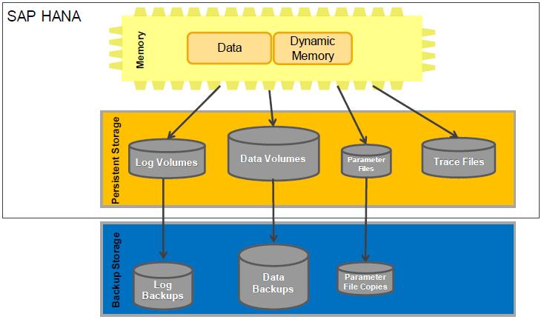
SAP HANA Persistence Layer

Slide 9
Persistency Description: Data & Log Volumes in Single Node Systems
Data & Log Volumes in Single Node
Data Volumes are organized in superblocks of 64 MB.
A superblock hosts pages of the same size.
Page sizes can vary from 4 kB to 16 MB.

Slide 10
Persistence Layer System Restart and Population of In-memory Stores
Actions During System Restart
Last savepoint must be restored plus…
Undo logs must be read for uncommitted transactions saved with last savepoint
Redo logs for committed transactions since last savepoint
Complete content of row store is loaded into memory
Column store tables may be marked for preload or not
Only tables marked for preload are loaded into
memory during startup.
If table is marked for loading on demand, the restore
procedure is invoked on first access.

Slide 11
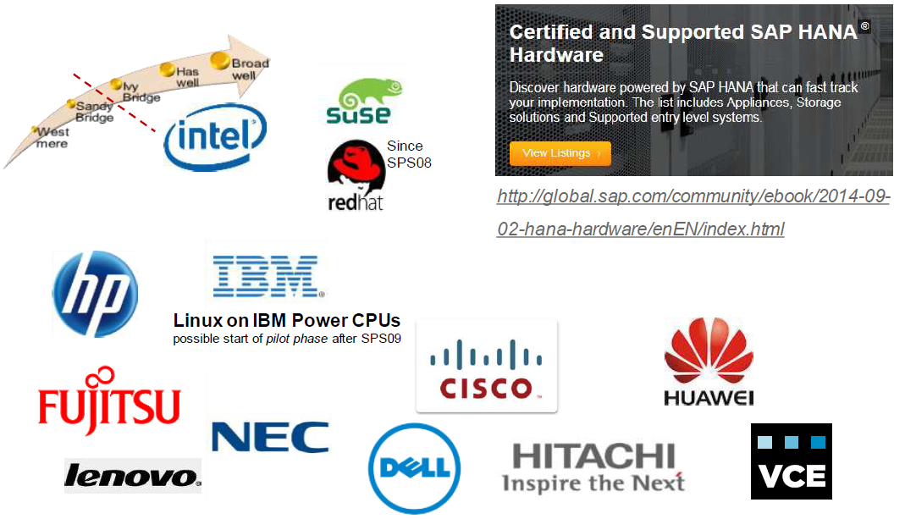
SAP HANA Scenarios SAP HANA Hardware Partners

Slide 12
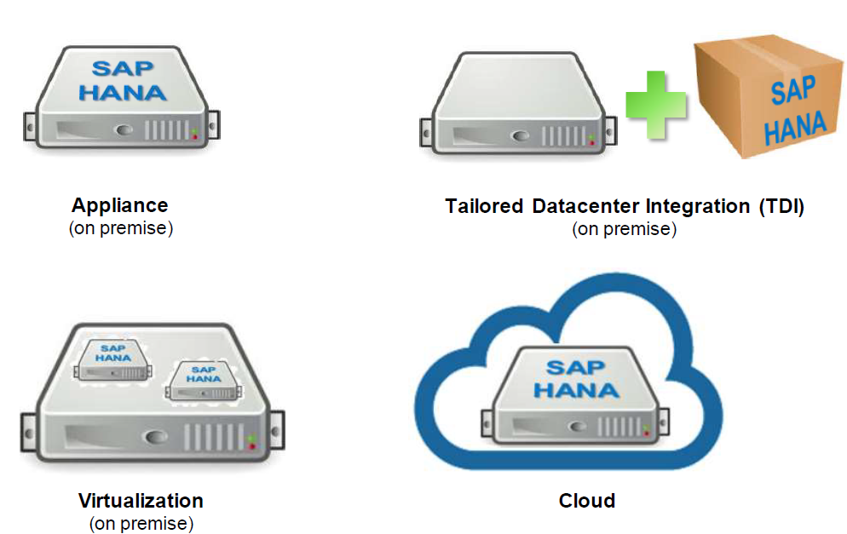
SAP HANA Scenarios Deployment Possibilities

Slide 13
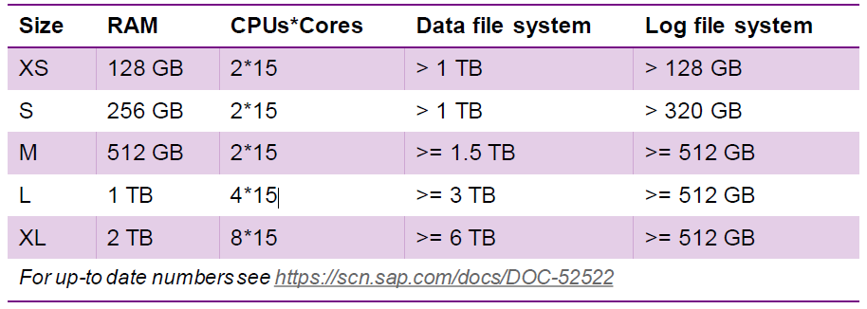
SAP HANA Scenarios Appliance
Originally SAP HANA was only available as an "appliance", i.e. as software preinstalled on certified hardware
Here are the single host size configurations available for Ivy Bridge technology and beyond (for older technologies see the PAM)
Important to take future growth into account when sizing a project since when scaling out from a single to multiple host system might require HW change also of the original host

Slide 14
SAP HANA Scenarios Tailored Datacenter Integration (TDI)
The "appliance" concept has softened – Now SAP HANA can be installed on your own
hardware, if
• the systems for the HANA installations are certified according to https://scn.sap.com/docs/DOC-52522
(for Ivy Bridge and onwards, for older technologies please see the PAM)
• the systems for the disks (for data and logs) are certified according to https://scn.sap.com/docs/DOC-48516
• the integration of existing enterprise components into the SAP HANA server is done properly, e.g. by the use of the HW Configuration Check Tool (provided and described in SAP Note 1943937) that checks
• data throughput and latency between HANA and external storages
• minimum bandwidth of the intro-node network, e.g. nodes in a multi-node system
• the software installation has been performed by certified persons

Slide 15
SAP HANA Scenarios Virtualization
SAP HANA on virtualized servers is supported on productive systems since SPS8 and on nonproductive systems since SPS6
Some restrictions:
• The only hypervisor supported for production
is VMware vSphere 5.5
• Virtual machines must be hosted on certified HW
• Only single-host systems are supported
• Installations must be performed by certified persons
• Memory over commitment is not supported
For more information see the SAP Note 1995460 - Single SAP HANA VM on VMware
vSphere in production or the documentation "SAP HANA Virtualized – Overview"
(http://scn.sap.com/docs/DOC-60329)

Slide 16
SAP HANA Scenarios Cloud
Software as a Service (SaaS)
Applications hosted by SAP on SAP HANA hardware (e.g. SAP Sales & Operations Planning)
Platform as a Service (PaaS)
SAP HANA Cloud Platform
Development toolset (e.g. native or java) to develop new applications on SAP HANA
SAP HANA One
Hosted on Amazon Web Services (AWS) for testing prototypes but could also be used
for production
Infrastructure as a Service (IaaS)
SAP HANA Enterprise Cloud (HEC)
Provides an infrastructure to run SAP HANA
and other SAP components on

Slide 17
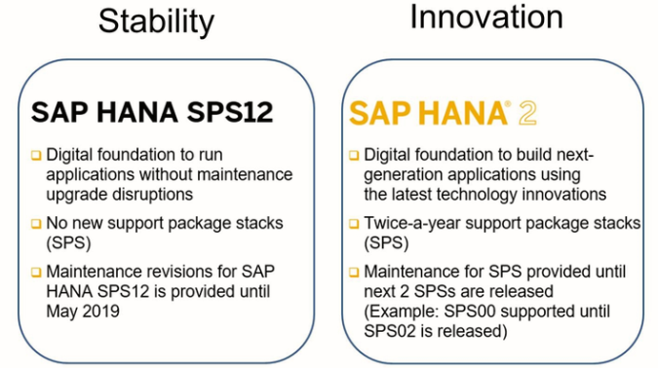
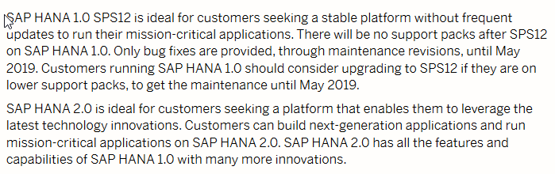
SAP HANA Scenarios

Slide 18
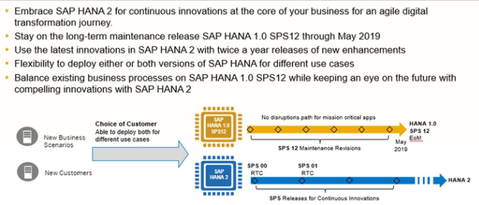
Maintenance Schedules for HANA 1.0 and HANA 2.0

Slide 19
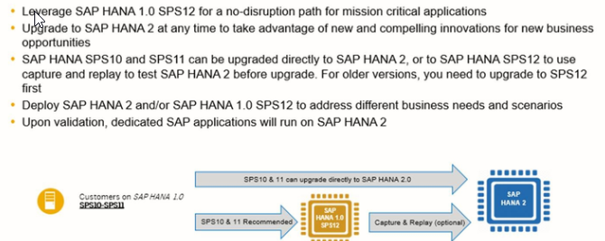
Upgrade Paths

Slide 20
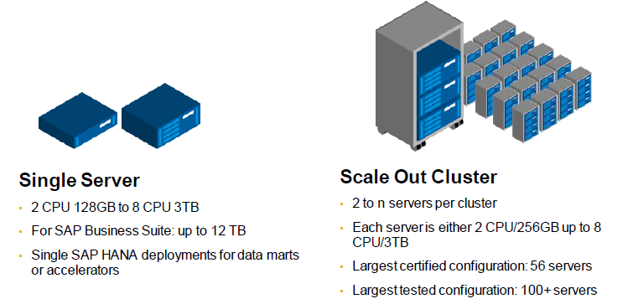
Single Host / Multi Node cluster configuration Scalability

Slide 21
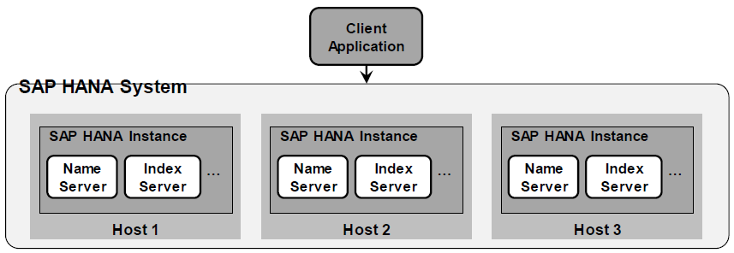
System Setup Distributed SAP HANA System
A SAP HANA system (defined by a System ID; "SID") is an administrative unit that can be installed,
started, stopped, backed up and connected to via clients
• A distributed SAP HANA System is installed on multiple hosts
• A host is a machine (with CPU, memory, storage, network and OS)
• A SAP HANA instance is a set of processes (index server, name server, …)
• The term node is used for the SAP HANA software that runs on one host (but no fixed relationship
since a node can be moved to another host)

Slide 22
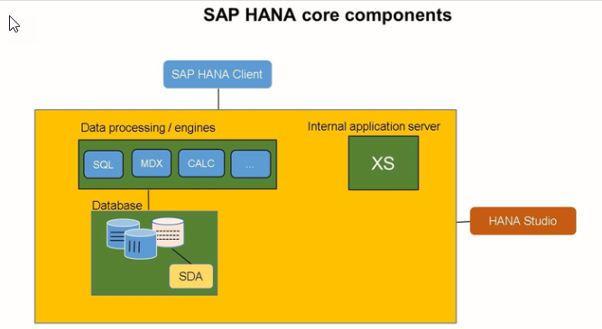
SAP HANA Core Components

Slide 23
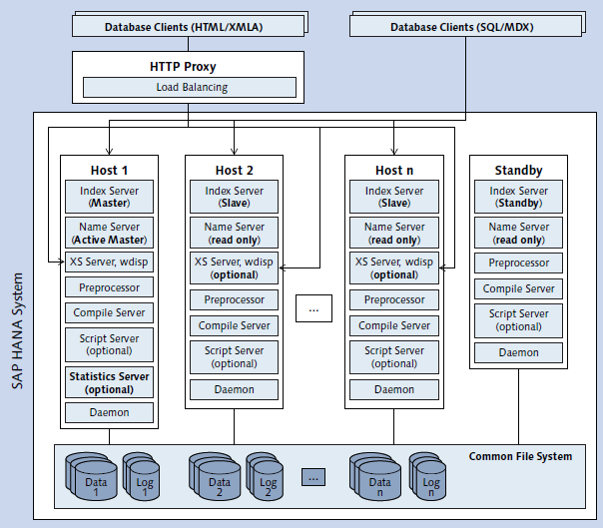
SAP HANA Core Components in Distributed System
A SAP HANA system (defined by a System ID; "SID") is an administrative unit that can be installed,
started, stopped, backed up and connected to via clients
• A distributed SAP HANA System is installed on multiple hosts
• A host is a machine (with CPU, memory, storage, network and OS)
• A SAP HANA instance is a set of processes (index server, name server, …)
• The term node is used for the SAP HANA software that runs on one host (but no fixed relationship
since a node can be moved to another host)

Slide 24
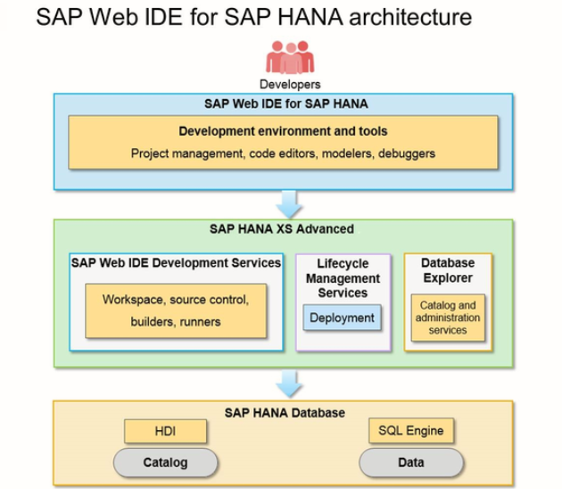
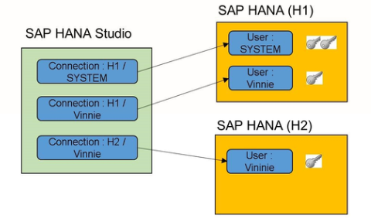
SAP HANA Studio & Web IDE

Slide 25
System Setup SAP HANA Deployment Options

Slide 26
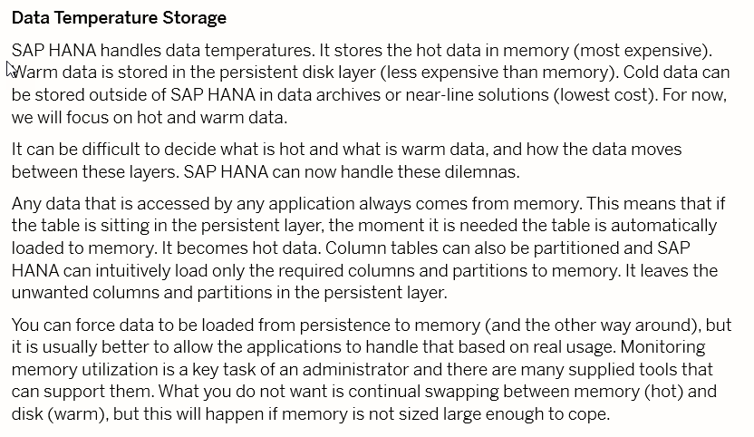
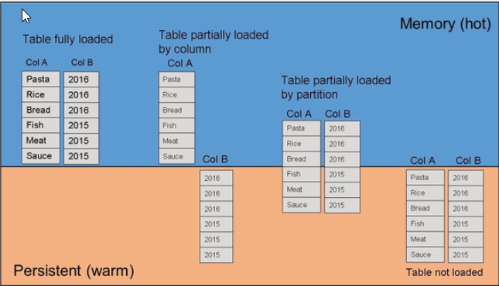
Data Temperature and Storage

Slide 27
System Setup Multi Tenancy
SAP HANA multitenant database containers ("MDC")
• One system with a system database and 0 – n tenant databases
• System DB keeps landscape information -> Globally config. & monitoring
• Tenant DBs are isolated -> users of one tenant DB are by default isolated
from data access of another tenant DB (they can be non isolated also)
• Tenant DBs can be backed up and recovered independently
• Tenant DBs use same rev. and same HA/DR method
• Run multiple applications on one
SAP HANA system in production
• Support for heterogeneous use cases in
one platform (Suite, BW, Data Marts,
Sandbox/Dev/QA/Prod)
Resource management
• CPU, Memory

Slide 28
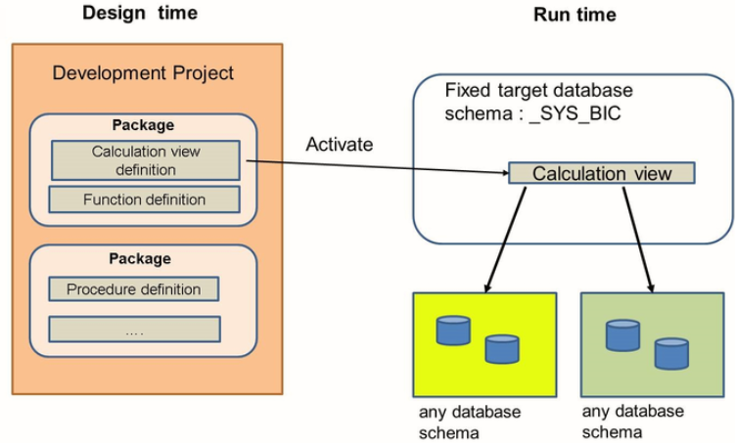
Run-Time and Design-Time Architectures

Slide 29
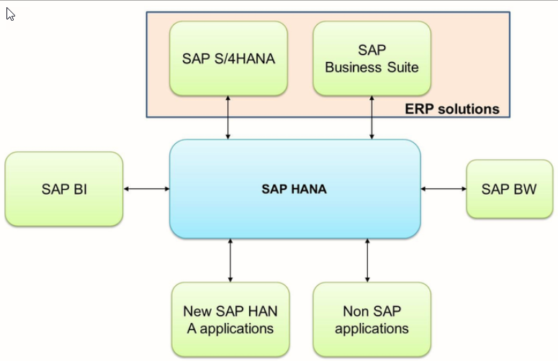
Applications that run on SAP HANA

